Slide 1

CSDA 1050 Final Marginal difference in rent price between tenured and new renters in Toronto
Nickolas LaL
August 27, 2019

Slide 2
Agenda
Sprint 1- The data collection, cleaning, and preliminary exploration and analysis phase of the project
Sprint 2- The modelling and analysis phase of the project
Final Conclusions

Slide 3
Sprint 1-Data Collection and Cleaning
Toronto Income data from 2013-2017
Annual Inflation
Ontario rent increase guidelines
Historical Toronto Rental Data

Slide 4
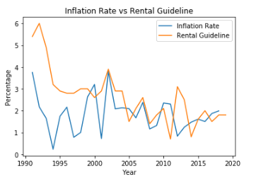
Sprint 1-Preliminary Exploration and Analysis
Generally the rent increase is always larger than inflation although there have been a few occasions where it was smaller.

Slide 5
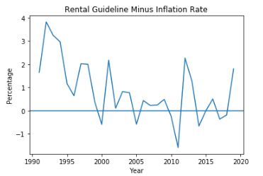
Sprint 1-Preliminary Exploration and Analysis
A better visualization of the gap in the rental increase guidelines vs the Inflation rate is displayed by plotting the difference, Guideline-Inflation rate.
We can better see that the rental guideline rate is usually higher, and occasionally lower or equal to the inflation rate.

Slide 6
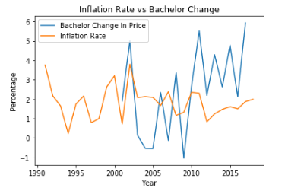
Sprint 1-Preliminary Exploration and Analysis
Next, we compare the Inflation rate with the change in price in each type of dwelling, starting with the change in the price of Bachelor apartments.
We can see that the Bachelor change in price is almost always greater than the rate of Inflation aside from a few exceptions where Inflation is equal to or lower than the Bachelor change.
We see this at roughly 2002-early 2006, late 2007-2008, and 2009-early 2010.

Slide 7
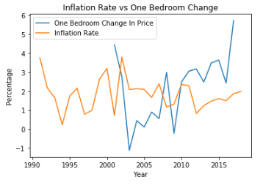
Sprint 1-Preliminary Exploration and Analysis
For One-Bedroom apartments we can see that the Inflation Rate was greater from about 2001-2008 and 2009-2010 and it was smaller otherwise.
There is also a sharp increase in the change in price from about 2015 onwards.

Slide 8
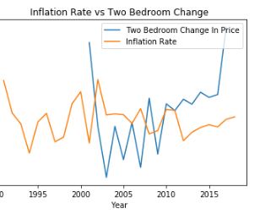
Sprint 1-Preliminary Exploration and Analysis
For Two-Bedroom apartments we can see there were many sharp increases and decreases in the change of price between 2001 and 2010.
We can also see the Inflation Rate was greater from about 2001-2008 and 2009-2010 and it was smaller otherwise.
There is also a sharp increase in the change in price from about 2015 onwards.

Slide 9
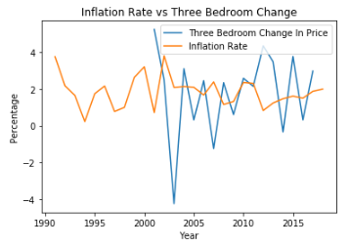
Sprint 1-Preliminary Exploration and Analysis
For Three-Bedroom apartments we can see there were many sharp increases and decreases in the change of price throughout, the biggest being the drop in 2003.
Aside from a few exceptions we can see the Inflation Rate was greater or roughly the same from about 2003-2010.
Aside from a few exceptions from about 2010 onwards the Inflation rate was smaller.

Slide 10
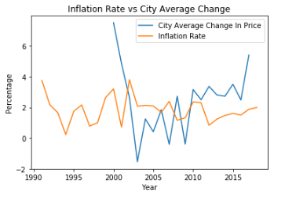
Sprint 1-Preliminary Exploration and Analysis
For the change in price of the city average we can see there were some sharp fluctuations in the change of price between 2001 and 2011.
We can also see the Inflation Rate was greater from about 2001-2007 and 2009-2010, it was smaller otherwise.
There is also a steep increase in the change in price from about 2015 onwards.

Slide 11
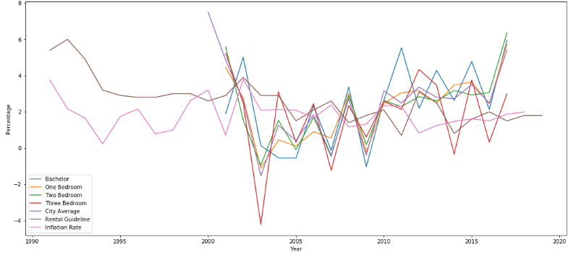
Sprint 1-Preliminary Exploration and Analysis
Finally, we are now plotting them all together to compare and get a visual on each individual apartment type alongside the city average, guideline, and inflation.

Slide 12
Sprint 2-Modelling and analysis
Sprint 2 contains the modelling/analysis phase of the project and it continues from where Sprint 1 ended. At the start of the project the goal was to try to identify the marginal difference in rent price between tenured renters and new renters in Toronto, specifically looking at apartments. During the completion of the Sprint and project many gaps were identified, and this became increasingly more difficult. This Sprint contains an attempt at forecasting the average apartment rent price in Toronto. This can be very useful for prospective renters, landlords, and the City of Toronto. The code and rationale are in the notebook and the report.

Slide 13
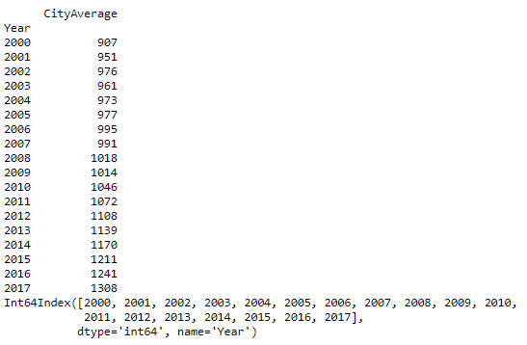
Sprint 2-Modelling and analysis
Here we are trying to forecast future average price using ARIMA. First, we create a new subset for only year and City Average price.

Slide 14
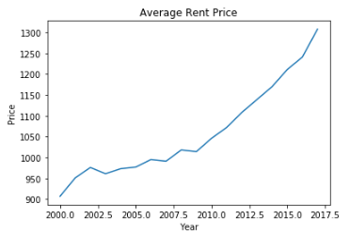
Sprint 2-Modelling and analysis
Before creating a forecasting model, we need to check for trends.
We are plotting the Average Rent Price and we can see a general upward trend

Slide 15
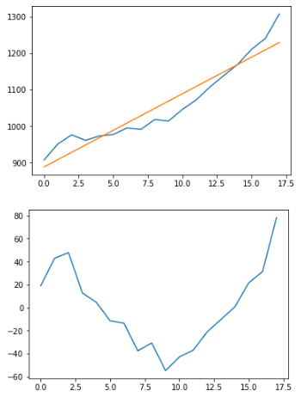
Sprint 2-Modelling and analysis
Next, we try to detrend by model fitting using a linear model. We calculate trend, plot it, try to detrend, and then plot that as well, detrended being the bottom graph.

Slide 16
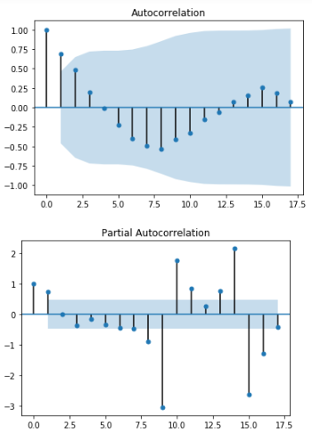
Sprint 2-Modelling and analysis
Next, we plot the ACF and PACF with 95% confidence interval to help show us the lag.

Slide 17
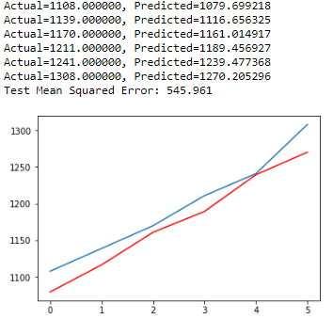
Sprint 2-Modelling and analysis
Finally, we create our ARIMA model and use it to predict. We use 70% of the data to train, and 30% to test the model. We also print the MSE to see how good the model is along with plotting the predictions against the actual. The prediction is red and the actual is blue, we can see that they intersect only once and are somewhat close, but not close enough.

Slide 18
Sprint 2-Modelling and analysis
We can see the MSE is 545.96 dollars meaning the model is over or underestimating the average rent price by 545.96 dollars. This model is not the best as that is too large a number and should be improved before it is used. Below are some ideas.
Perhaps there are stationary issues and the model is not fully stationary and needs to be better transformed, maybe stabilizing the variance, this can all be tested.
Perhaps multiple models with different AR and MA terms.
Perhaps other modelling techniques.
Perhaps more/better data.

Slide 19
Sprint 2-Modelling and analysis
Although ARIMA does not consider economic and political conditions, or correlations of all factors related to rent prices perhaps after the example above is cleaned up it can be useful for forecasting the average apartment rent price in Toronto.

Slide 20
Final Conclusions and Recommendations
As previously mentioned, the model should not be currently used as is. The MSE is too high and the model is not very useful and previously outlined were some potential solutions to help improve it along with why it may not have been very useful.

Slide 21
Final Conclusions and Recommendations
Throughout the completion of the project there were many issues, obstacles, and challenges that were met along the way. Not all were completely resolved, and these were the key contributors to the many ways the project could be improved in the future (aside from the issues with the actual model). These will be outlined. Upon reflection it appears that the number one problem was the actual data that was collected and cleaned for analysis. The data collection and cleaning are vital as they lay the foundation for the project. If not done correctly it can cause major problems down the road, like with this project.

Slide 22
Final Conclusions and Recommendations
Generally, more data overall as well was more complete data.
Higher quantity more complete/rich income data, perhaps with locations, education, etc and for more years.
Data on the actual amount spent on rent, or actual rent expenditure, ideally in a dataset that includes geographical information, properties of dwelling, duration of stay, etc along with changes seen in the above characteristics. This was the key missing piece that was needed and could not be located and loaded to be properly used for analysis.
Geographical data to better understand, identify and visualize areas as location is one of the biggest factors in housing prices.
Generally, more practice with Geopandas and forecasting to help all the above.

Slide 23
Final Conclusions and Recommendations
Although the original research question was changed along the way and the final model was not particularly useful and although the final product was not ideal or what was expected a lot was learned! The above project was a unique and very rich learning experience! It encompassed a complete data analysis project from the very beginning to very end along with all the challenges that come with it.

Slide 24
Sources
https://www150.statcan.gc.ca/t1/tbl1/en/tv.action?pid=1110023901&pickMembers%5B0%5D=1.17&pickMembers%5B1%5D=2.1&pickMembers%5B2%5D=3.1&pickMembers%5B3%5D=4.1
https://www.inflation.eu/inflation-rates/canada/historic-inflation/cpi-inflation-canada.aspx
https://www.ontario.ca/page/rent-increase-guideline
https://www.torontorentals.com/blog/average-rent-in-toronto-since-2000#2008
http://geopandas.org/io.html#reading-spatial-data

